Slide 1
Do Now
Write this numbers in expanded form and evaluate
2²
3⁵
5⁴
4³
1⁶
Notes:
Ask students do they know what 2^2 and 4^3 is called?

Slide 2

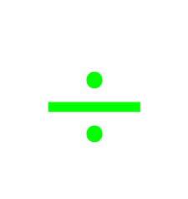







My Number
Interactive Notebook
$$×$$
$$\frac{1}{2}$$
$$÷$$
$$+$$
$$−$$
$$\frac{3}{5}$$
$$7$$
Name
Class
Teacher
Term 1 Semester 1
$$5^{2}$$
$$\sqrt{9}$$
1

Slide 3
Contents
Glossary or Formula Page
Page
Date
Description
2
3

Slide 4

24
7
30
Tasks
24
7
30
Essential Question
Complete the following tasks on this side (left) of your page
Questions
Notes
You should be ticking these off!
Summary
Have YOU been doing your summaries?
Your book, your responsibility!

Slide 5
24
7
30
Date
Index Notation
EQ – Describe the relationship between squaring a number and finding the square root?
9

Slide 6
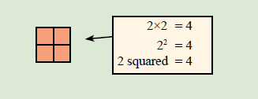
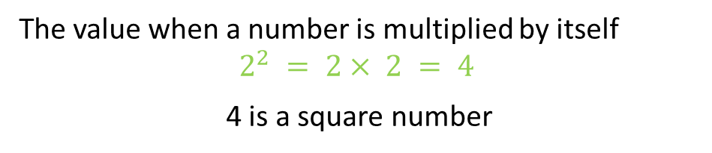
24
7
30
Date
Index Notation
EQ – What are squared and cubed numbers.
What is a square number?
The value when a number is multiplied by itself
$$2^{2} = 2× 2 = 4$$
4 is a square number
9
Notes:
Explain to students why it is called a square number. 2 squared is creating a square which is 2 unit squares in length. How many unit squares do I have in hear.

Slide 7


Calculate the following
$1^{2}=1×1=1$
$2^{2}$
$3^{2}$
$4^{2}$
$5^{2}$
$6^{2}$
$7^{2}$
$8^{2}$
$9^{2}$
${10}^{2}$
${11}^{2}$
${12}^{2}$
Notes:
Handout square graph paper to students to solve this. Ask students to do this without the calculator.

Slide 8
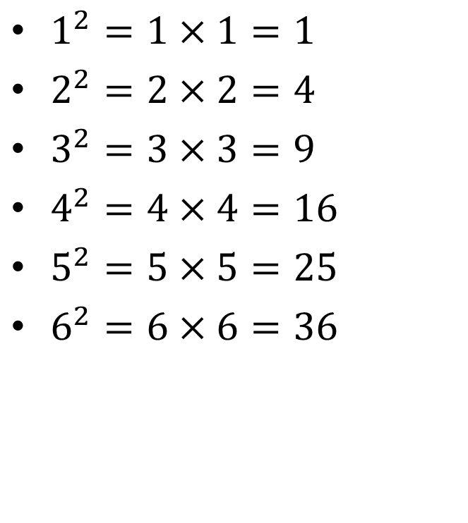
Calculate the following
$1^{2}=1×1=1$
$2^{2}=2×2=4$
$3^{2}=3×3=9$
$4^{2}=4×4=16$
$5^{2}=5×5=25$
$6^{2}=6×6=36$
$7^{2}$
$8^{2}$
$9^{2}$
${10}^{2}$
${11}^{2}$
${12}^{2}$

Slide 9
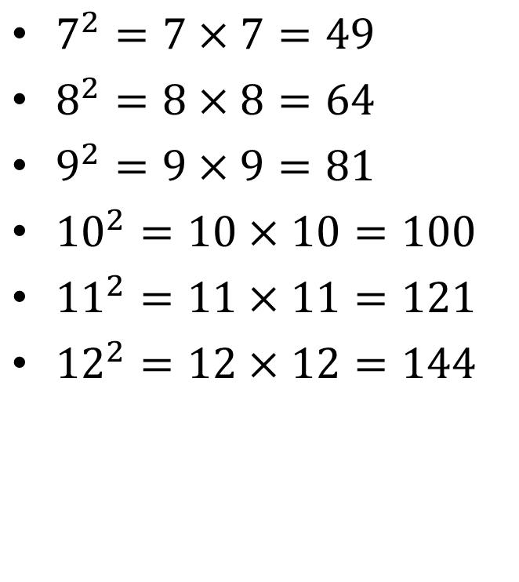
Calculate the following
$1^{2}=1×1=1$
$2^{2}=2×2=4$
$3^{2}=3×3=9$
$4^{2}=4×4=16$
$5^{2}=5×5=25$
$6^{2}=6×6=36$
$7^{2}=7×7=49$
$8^{2}=8×8=64$
$9^{2}=9×9=81$
${10}^{2}=10×10=100$
${11}^{2}=11×11=121$
${12}^{2}=12×12=144$

Slide 10

Calculate the following
${35}^{2} \left\{3×4=12\right\} Answer=1225$
${45}^{2}$
${55}^{2}$
${65}^{2}$
${75}^{2}$
${85}^{2}$
Notes:
Handout square graph paper to students to solve this. Ask students to do this without the calculator.

Slide 11
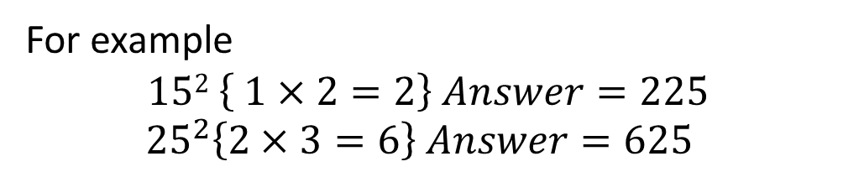
24
7
30
Date
Index Notation
EQ – What are squared and cubed numbers.
What is a square number?
The value when a number is multiplied by itself
$$2^{2} = 2× 2 = 4$$
4 is a square number
Squaring Number ending with 5
To square any two digit number ending in 5:
First digit × (first digit + 1) then attach 25 to the answer.
For example
$$152 \left\{ 1×2=2\right\} Answer=225$$
$${25}^{2}\left\{2×3=6\right\} Answer=625$$
9
Notes:
Explain to students why it is called a square number. 2 squared is creating a square which is 2 unit squares in length. How many unit squares do I have in hear.

Slide 12

24
7
30
Date
Index Notation
EQ – Describe the relationship between squaring a number and finding the square root?
3.2² is between which two squares?

Slide 13
Let’s do these together
3.7² is between which two squares?
4.5² is between which two squares?
6.5² is between which two squares?
7.4² is between which two squares?

Slide 14
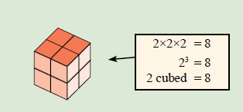
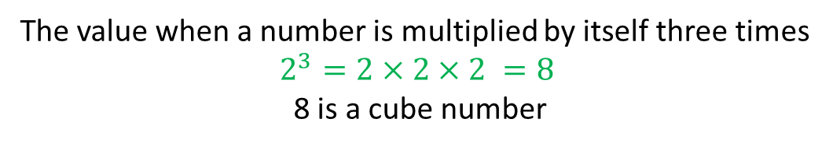
24
7
30
Date
Index Notation
EQ – Describe the relationship between squaring a number and finding the square root?
3.2² is between which two squares?
What is a cube number?
The value when a number is multiplied by itself three times
$$2^{3}=2×2×2 =8$$
8 is a cube number
9

Slide 15


Calculate the following
$1^{3}=1×1×1=1$
$2^{3}$
$3^{3}$
$4^{3}$
$5^{3}$
$6^{3}$
$7^{3}$
$8^{3}$
$9^{3}$
${10}^{3}$
${11}^{3}$
${12}^{3}$
Notes:
Handout square graph paper to students to solve this. Ask students to do this without the calculator.

Slide 16
Notes Review
24, 7 ,30
Date
Title
Essential question
Notes complete
Notes complete with colour and diagrams
Questions completed
Contents page filed in
Formula page filled in

Slide 17
Homework
Review your notes and write a summary answering the essential question.

